Slide 1
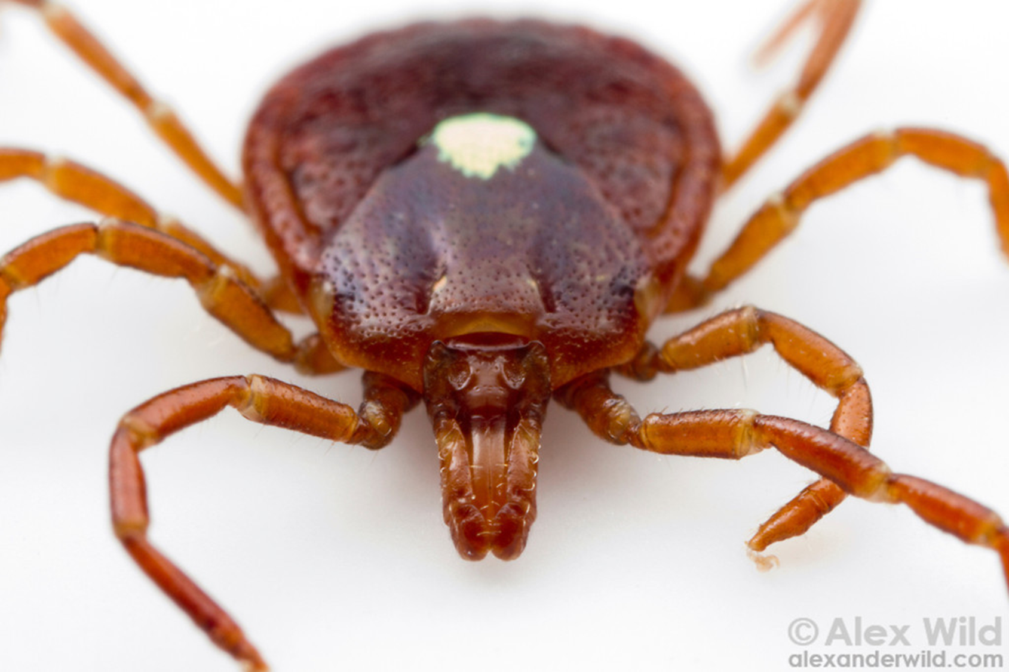

Ticks and Their Diseases
Maureen Brophy, MPH
Ph.D. Student

Slide 2
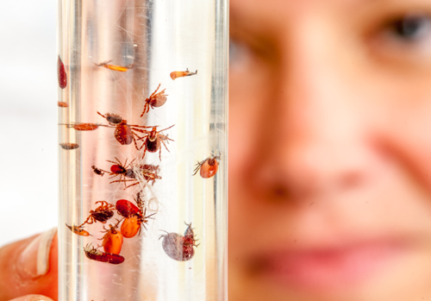
Outline
What are ticks?
Biology
Ecology
Disease transmission
Rocky Mountain spotted fever

Slide 3
What is a tick?
Arachnids, not insects
  Related to spiders
External parasites of mammals, birds, and reptiles
>800 species describes worldwide
~80 species in the U.S.
Leading disease carriers in United States
  Second to mosquitoes worldwide

Slide 4
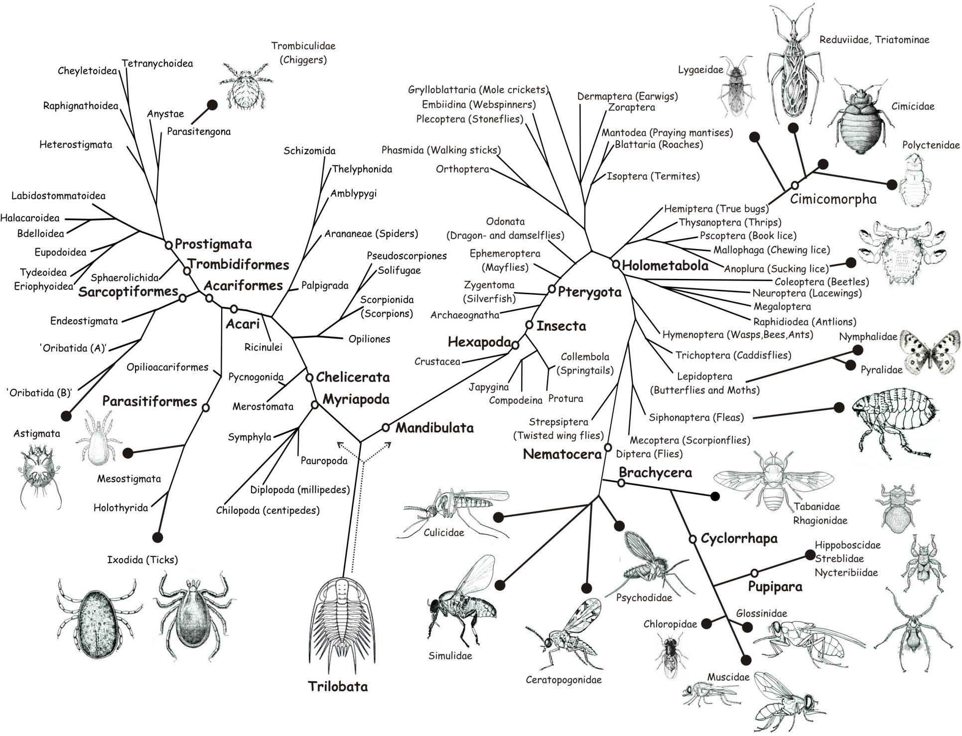
Arthropods That Feed on Vertebrate Blood

Slide 5
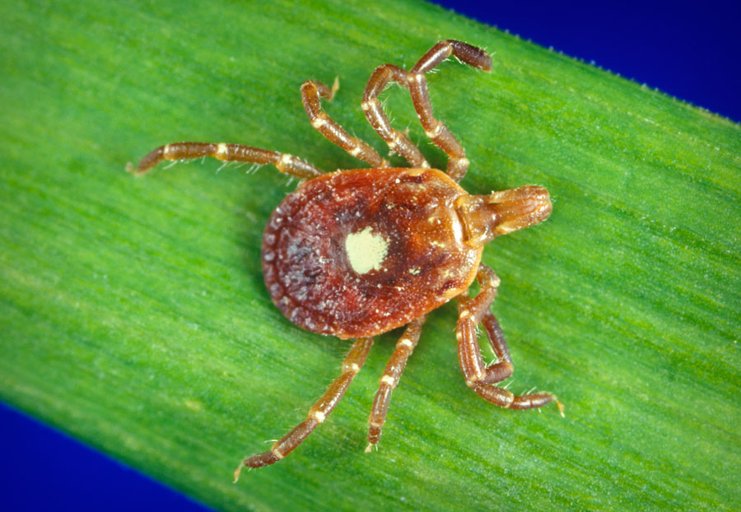
How to Spot a Tick
Very small, but bigger after meal
8 legs*
Mostly oval
*Except larvae

Slide 6
Hard vs. Soft Ticks
Ixodid = hard ticks
Argasid = soft ticks

Slide 7
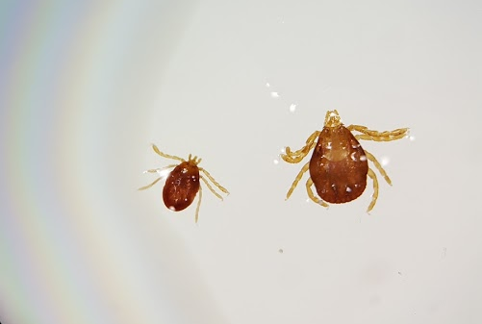
Life Cycle

Slide 8
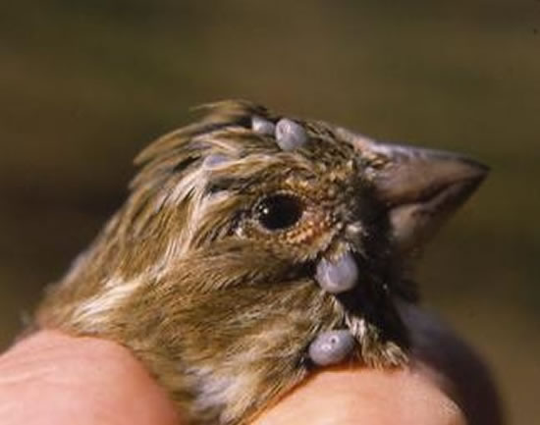
How to Ticks Find Hosts?
Questing
Hunting
Step 1- Find grass, bush, twig, etc.
Step 2- Climb to top of it
Step 3- Extend forelegs
Step 4- Wait
Step 5- Latch onto passing host
Step 1- Sense host
Step 2- Chase host
Step 3- Catch host

Slide 9
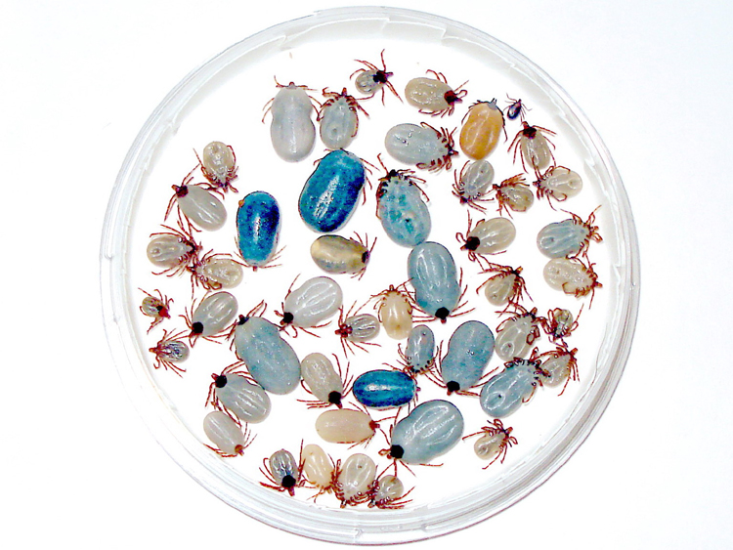
Biology

Slide 10
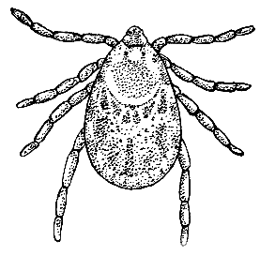
External Anatomy

Slide 11
External Anatomy
Body
Top side- scutum
Females have “shield”
  Allows for body to grow during feeding
  Can grow many times original size after feeding

Slide 12
External Anatomy
“Head”/mouth area
Basis capitulum

Slide 13
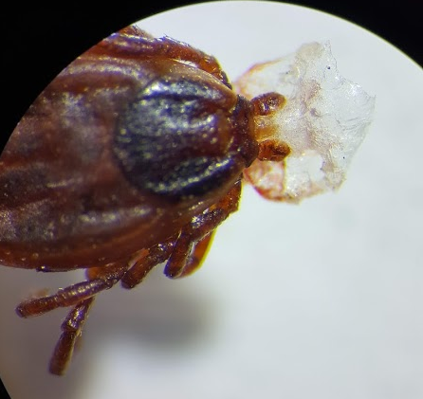
External Anatomy
Mouthparts
  Hypostome
  Chelicerae
  Palps

Slide 14
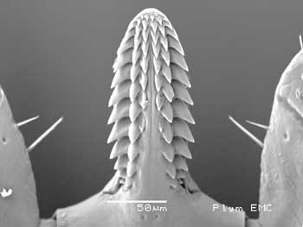
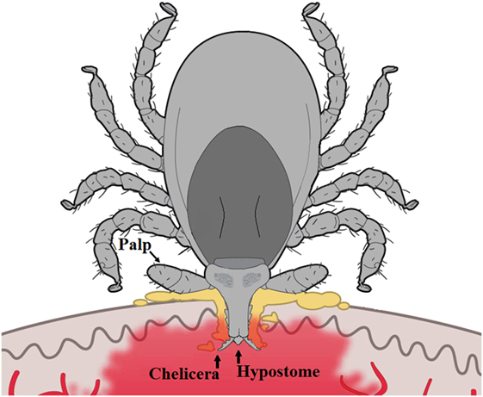

Slide 15
Saliva
Excrete concrete-like saliva into wound, create feeding tube
Contains anesthetic, anti-coagulants, immunosuppressants, vasodilators
Also helps with water regulation

Slide 16
External Anatomy
Legs
3 pair (6 legs) as larva
4 pair (8 legs) as nymph and adult
Good for grabbing and climbing

Slide 17
External Anatomy
Sensory
“Hairs” on legs and body sense vibration
Haller’s organ “smells” chemical cues from host
Basic eyes

Slide 18
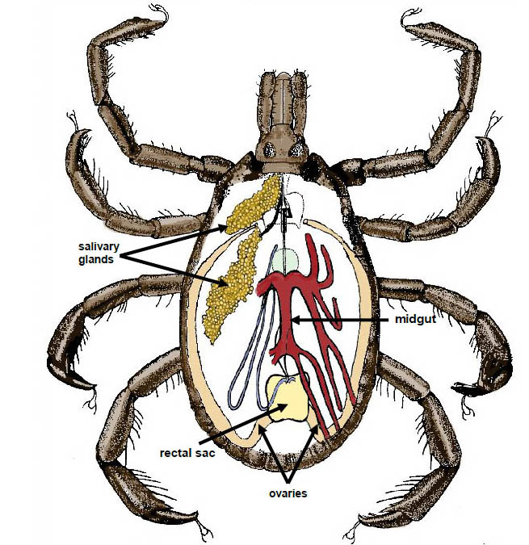
Internal Anatomy
Diverticulated gut
Salivary glands grow during feeding
Malpighian tubule helps absorb nutrients

Slide 19
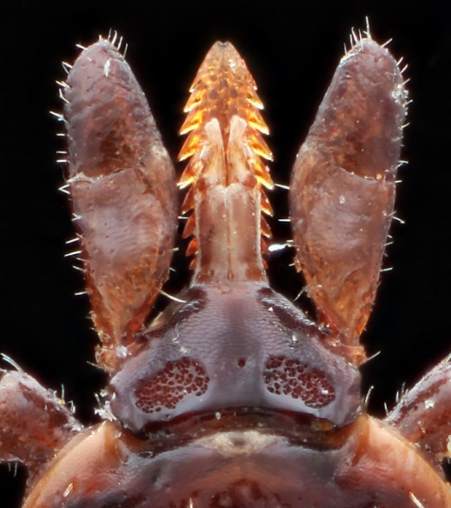
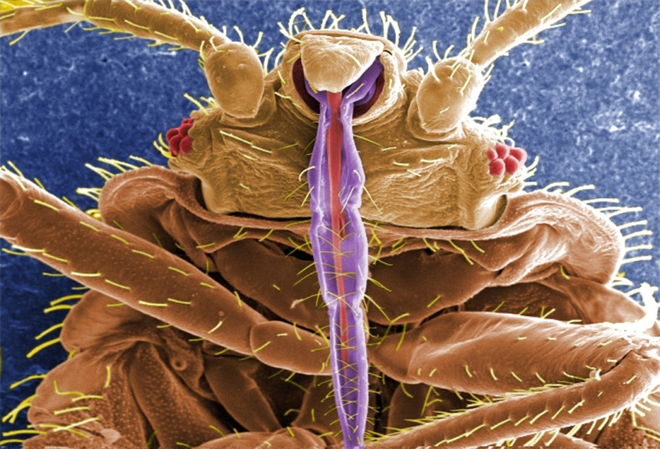
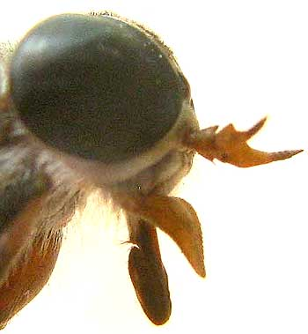
Blood Feeding Requirements
Sensory apparatus to locate vertebrate host
Specialized piercing-sucking mouthparts
Saliva components to prevent blood coagulation and host immune response
Capacity to deal with dramatic increase in gut volume

Slide 20
Number of Hosts
Depends on tick species

Slide 21
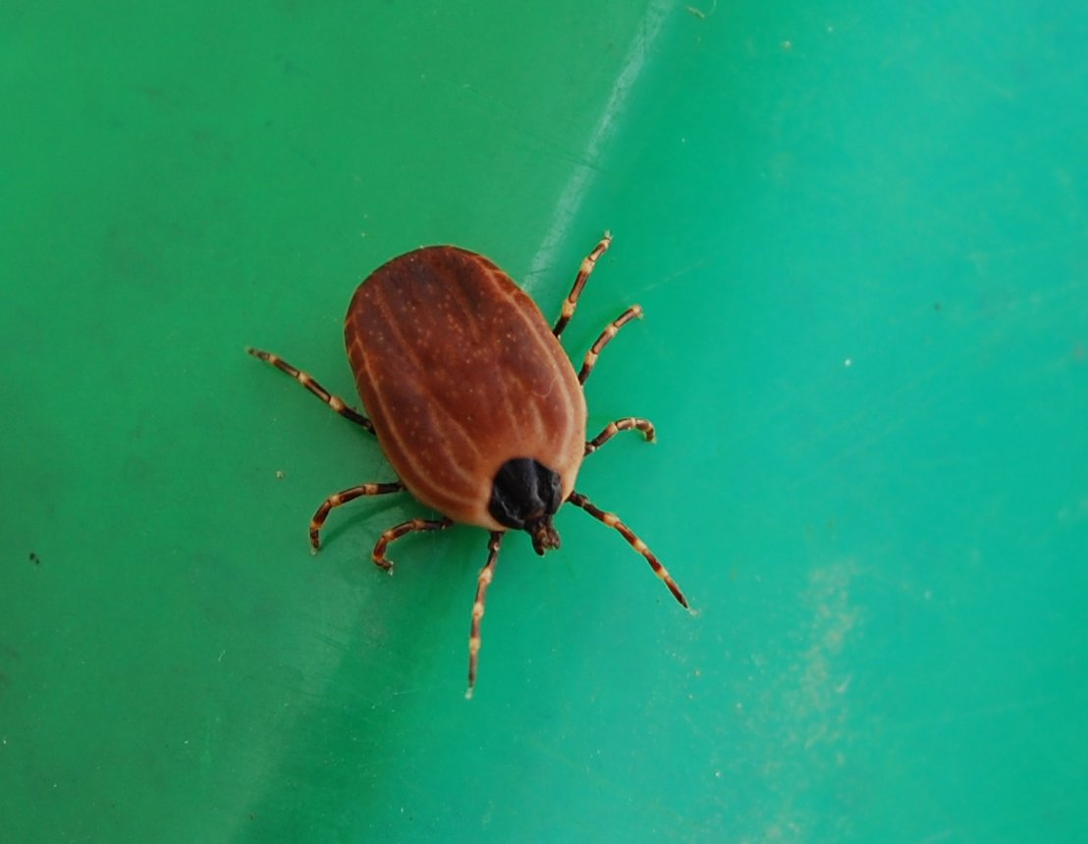
Ecology

Slide 22
Where Do Ticks Live?
Depends on type of tick
Dog ticks- near home, wherever they can find dogs
Soft ticks- in nests, caves, where they can find birds, bats, rodents
Other ticks (Dermacentor, Amblyomma)- In wooded areas, scrub, where they can find rodents and larger mammals

Slide 23
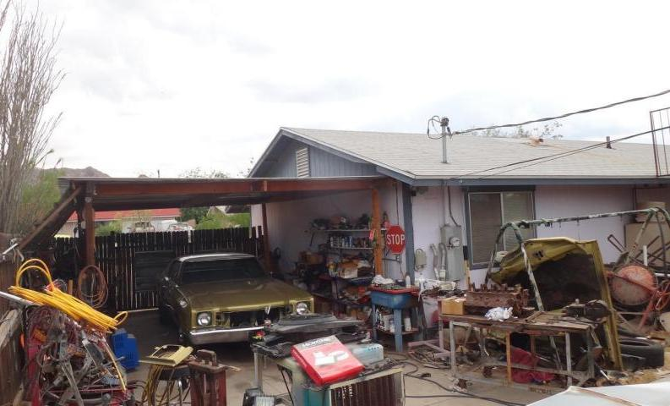
Peridomestic Environment
Dog ticks live close to home
Items in yard (old furniture, toys, appliances, trash) can provide shelter and breeding sites for ticks
Where the dogs go, the ticks go

Slide 24
Ticks on Navajo Nation
Ixodid
  Rhipicephalus sanguineus
  Dermacentor andersoni
Argasid
  Ornithodoros species

Slide 25
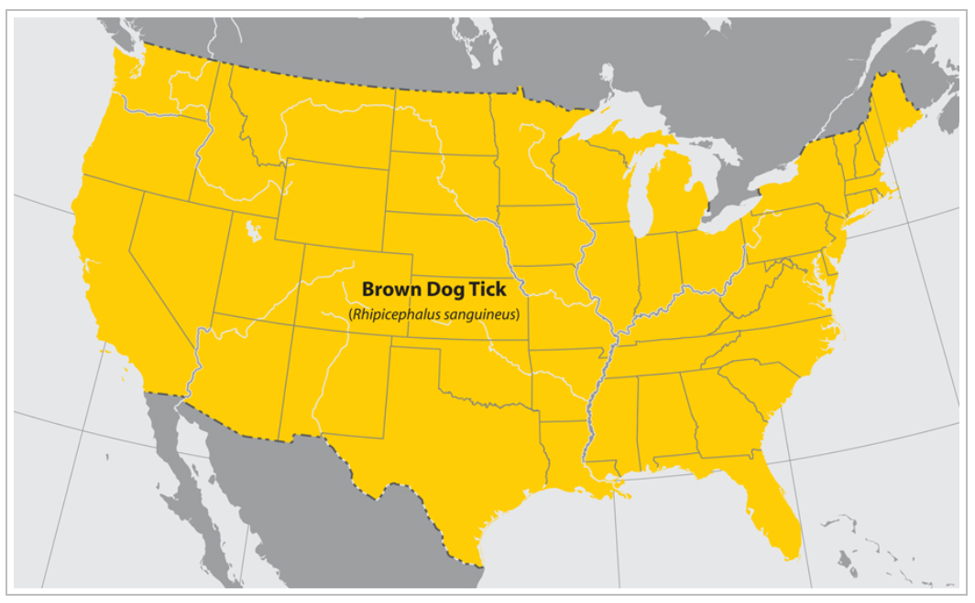

Slide 26
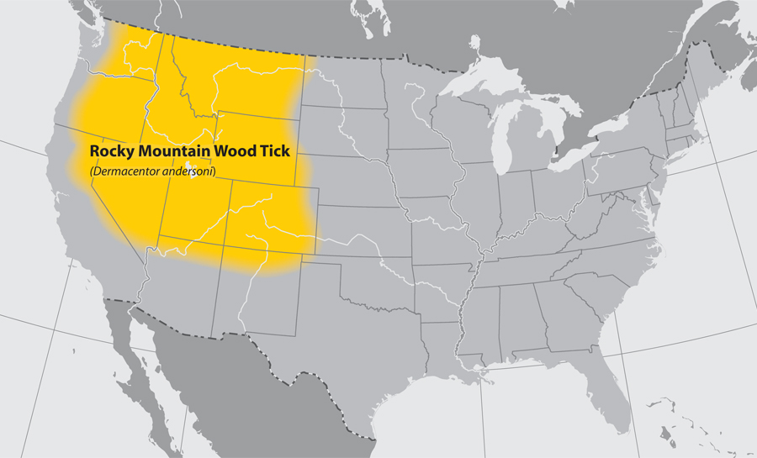

Slide 27
Disease Transmission

Slide 28
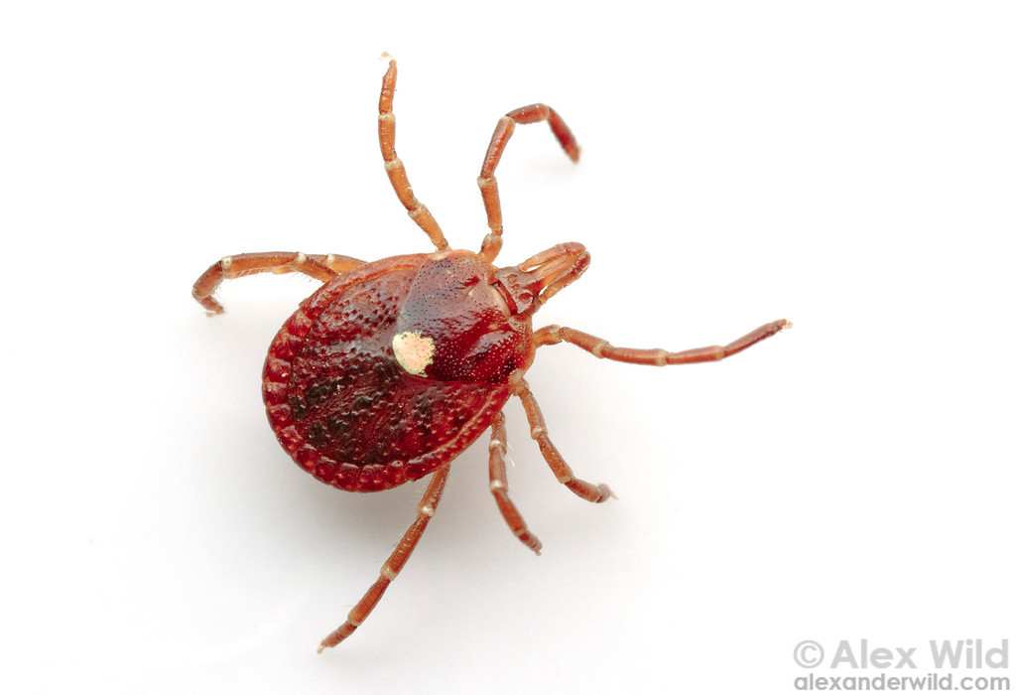
Tickborne relapsing fever (TBRF)
Granulocytic Anaplasmosis
364D rickettsiosis
Powassan disease
Colorado tick fever
Babesiosis
Heartland virus
Ehrlichiosis
Bourbon virus
Borrelia mayonii
Anaplasmosis
Rickettsia parkeri rickettsiosis
Borrelia miyamotoi
Tularemia
Lyme disease
Alpha-gal
STARI (Southern tick-associated rash illness)
Rocky Mountain spotted fever (RMSF)

Slide 29
How Do Ticks Get Infected?
Horizontal Transmission- pathogen is acquired from a host, develops or multiplies in tick, and is transmitted to next host
Vertical Transmission- female lays infected eggs, ticks can infect in larval form

Slide 30
Tick-borne Diseases in Arizona
Rocky Mountain spotted fever
Ehrlichia canis
Tularemia
Tickborne relapsing fever

Slide 31
Rocky Mountain Spotted Fever

Slide 32
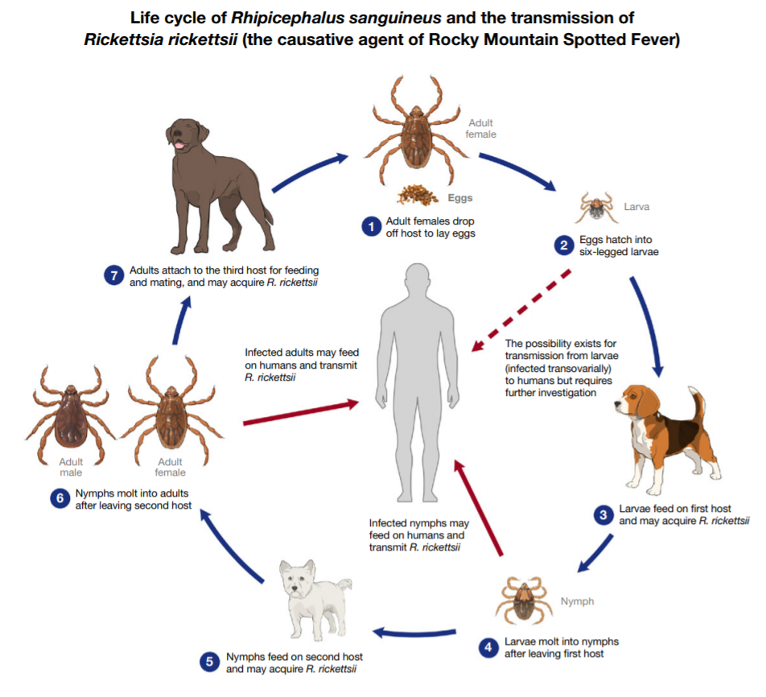
Disease Cycles

Slide 33
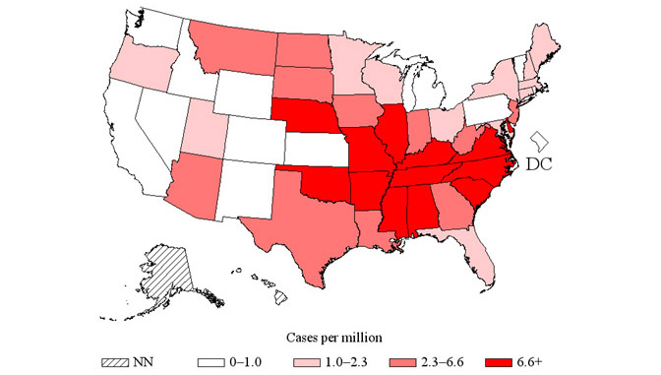
Distribution
2014 Incidence Map: CDC
Notes:
Diseases spread and shift all the time, but something is different this time.
BDT is found world-wide & throughout US, and RMSF is found at least throughout the US. Why, then, are these ticks not spreading the disease elsewhere?
RMSF is spread by different ticks- RM wood tick & American dog tick. These have fewer encounters with humans -> more sporadic cases, not clusters
380 cases & 23 deaths from RMSF in Arizona since 2003
1,394 cases & 247 deaths in Sonora, MX during same time
Of course, these may likely be underestimates of the actual burden of disease based on similarity of symptoms to other illnesses, misdiagnosis, and other reasons

Slide 34
Distribution
In Arizona, brown dog tick is vector (Dermacentor ticks in other parts of the country)
Higher case fatality rate

Slide 35
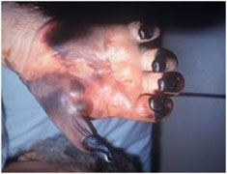
Symptoms
Fever
Headache
Rash
Nausea & vomiting
Stomach pain
Muscle pain
Lack of appetite
Can be deadly if left untreated
Most common in young children
Notes:
Symptoms are similar to other diseases, possible to overlook. But can lead to serious complications even be deadly w/o antibiotics. Most common in AZ among young children, who are so often playing and cuddling with their dogs, unaware of the risks of tick bites.

Slide 36
Risk Factors
Roaming dogs
Dogs not spayed/neutered
Clutter in yard
Dogs can get RMSF too
Dogs CANNOT give humans RMSF

Slide 37
Prevention
Check for ticks
Remove ticks immediately if found
Reduce yard clutter
Apply tick collar or topical pesticide on dogs
Use environmental pesticide (properly) if there is a tick infestation

Slide 38
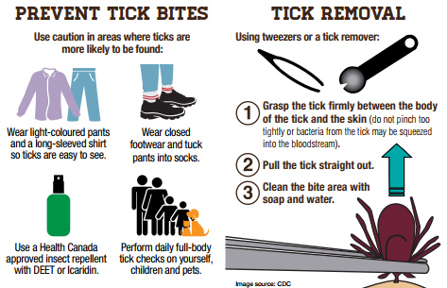
Prevention

Slide 39
Treatment
Doxycycline ASAP
If you have RMSF symptoms and (might have had) exposure to ticks, seek medical care (and tell them to test for RMSF)
Doxycycline is safe and does not stain children’s teeth

Slide 40
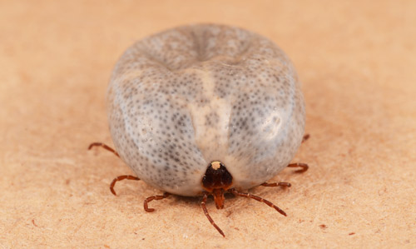
Maureen Brophy
PhD Student
University of Arizona
Brophymk@email.arizona.edu

